Slide 1
Needle Shot by: Parsa Hassani

Slide 2
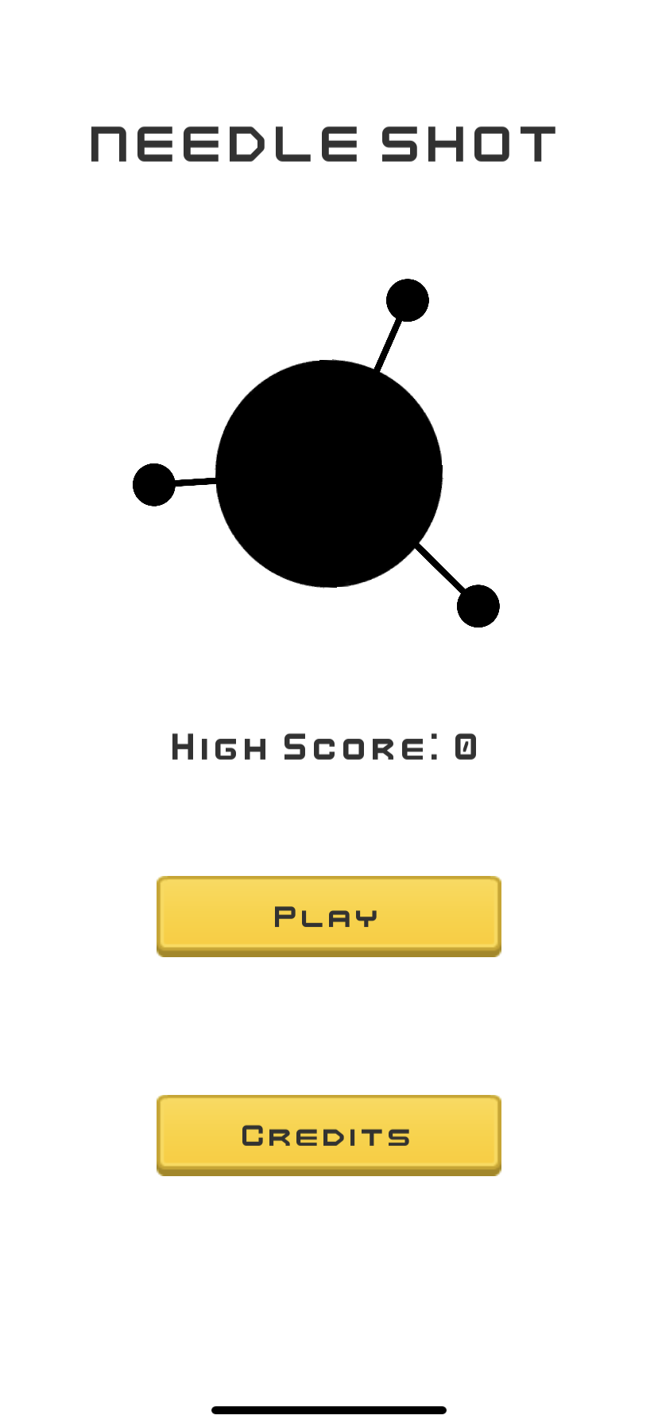
The Game
Needle Shot was inspired to be a mobile game because of a previous game I released in the App Store and Play Store.

Slide 3
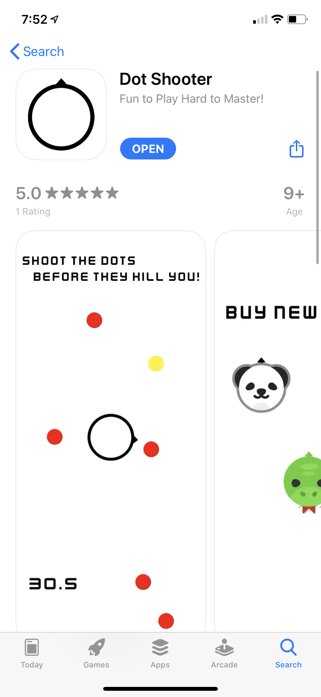
The Art
Dot Shooter
I am generally a big fan of minimalistic art styles, so I used the style of my previous game, Dot Shooter, to create a more minimal aesthetic.
Picture of Dot Shooter on App Store

Slide 4
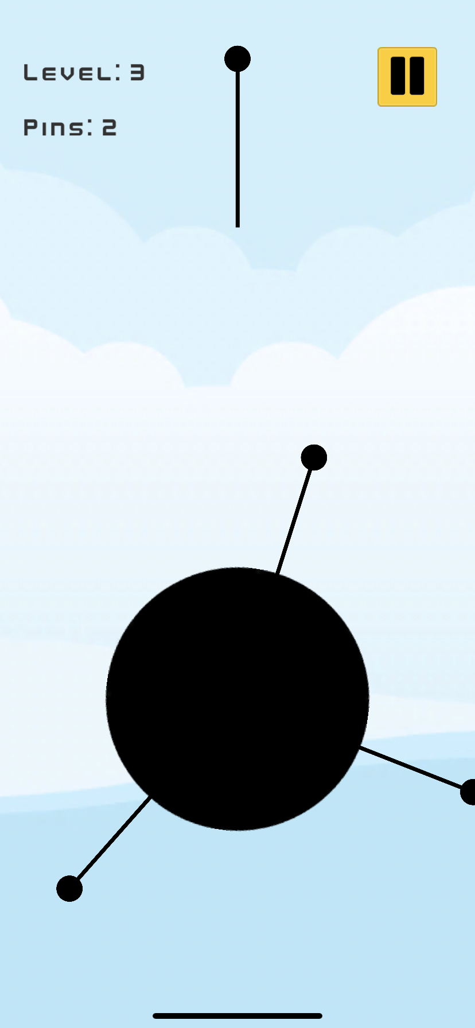
The Development
One of the biggest hurdles in programming this was:
Creating the logic behind needles sticking to top of the circle
Implementing the level system and keeping variables in order between scene changes

Slide 5
Future Implementations
Some ideas that can be included in the future:
Universal leaderboard across multiple users and devices
Better consistent variations between difficulty of levels
More Powerups for the player
Cleaner UI
More animations

Slide 6
Thanks!
With this project is an apk to play this on an Android device.

